Slide 1
Project Title:
E-Commerce Website
(d-cart)

Slide 2
Team
Group Number:4
Team Members and Roll Numbers.:
Member 1: Aryan(2210990175)
Member 2: Ashish Tantubai(2210990188)
Member 3: Avinash Kumar Jha(2210990200)

Slide 3
Index
Introduction
Objective
Functionalities Used
Snapshots
Result
Reference
Conclusion

Slide 4
Introduction
Welcome to D-Cart Ecommerce Platform
In the bustling world of online commerce, creating a seamless and intuitive shopping experience is paramount. With that vision in mind, we proudly introduce D-Cart a cutting-edge ecommerce platform developed using React.
At D-Cart our mission is simple: to provide users with an engaging and hassle-free shopping journey from start to finish. Leveraging the power and flexibility of React, we've crafted a dynamic and responsive web application that caters to the diverse needs of modern consumers.

Slide 5
Objective
Our objective is to create a cutting-edge ecommerce platform leveraging React, with a focus on delivering a seamless and intuitive shopping experience for users. Through responsive design and personalized recommendations, we aim to enhance engagement and drive conversions. Scalability is a key priority, ensuring our platform can accommodate growth and maintain optimal performance. We seek to streamline the checkout process, reducing friction and minimizing cart abandonment rates. Security is paramount, and we are committed to implementing robust measures to protect customer data and build trust.

Slide 6
fUnctionalities used
JavaScript: React.js itself is a JavaScript library for building user interfaces. JavaScript is used extensively for client-side logic, handling events, managing state, and interacting with the DOM.
JSX: JSX is a syntax extension for JavaScript used with React.js to describe what the UI should look like. It allows developers to write HTML-like code within JavaScript files, making it easier to write React components.
HTML (HyperText Markup Language): HTML is used to structure the content of web pages, including defining the layout, headings, paragraphs, links, and other elements of the user interface.
CSS (Cascading Style Sheets): CSS is used for styling the HTML elements and defining the visual presentation of the website, including layout, colors, fonts, spacing, and responsiveness.
Node.js: Node.js can be used for server-side logic, handling HTTP requests, and interacting with databases. While not strictly necessary for a basic e-commerce website, it might be used for implementing server-side rendering, building APIs, or handling back-end tasks.
JSON : JSON is commonly used for exchanging data between the client and server. It's often used for storing product information, user data, and configuration settings.

Slide 7
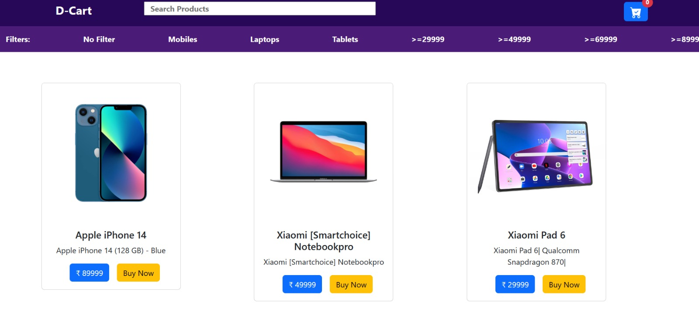
Snapshots
Home Interface

Slide 8
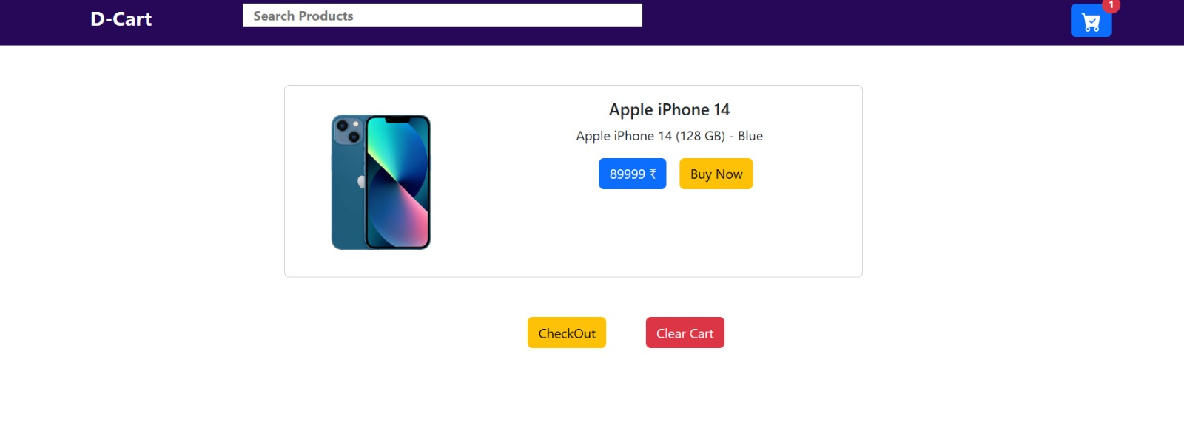
Snapshots
Add to Cart Functionality

Slide 9
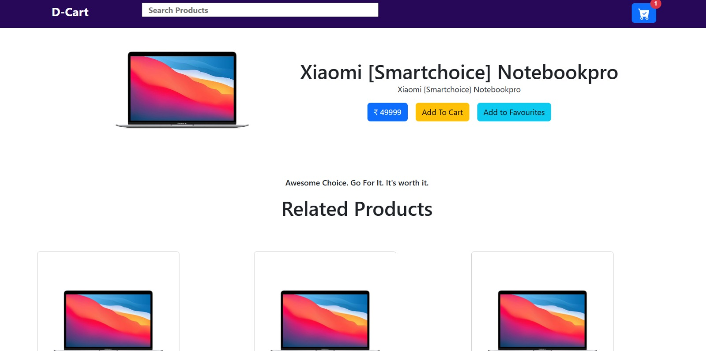
Snapshots
Product Description

Slide 10
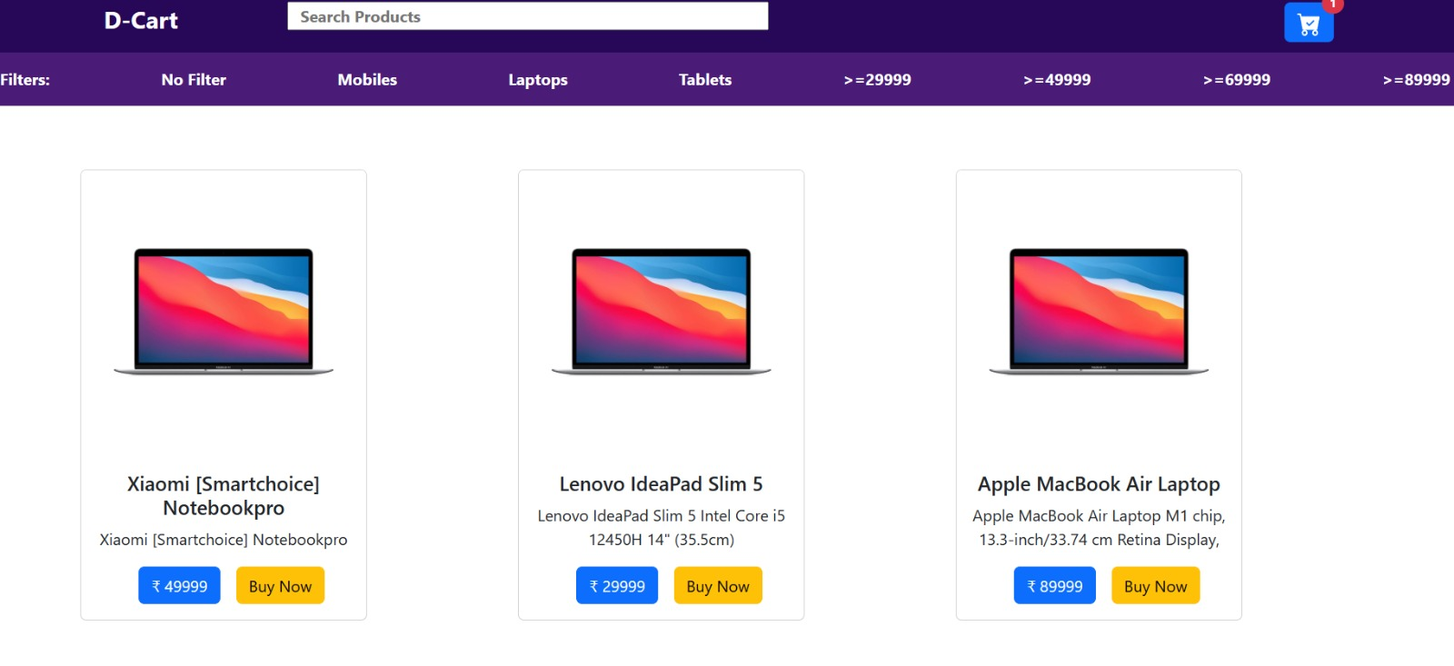
Snapshots
Finding Products using Filter

Slide 11
Result
With our ecommerce website project using React, expect a transformative experience for both customers and our business. Streamlined navigation and personalized recommendations will enhance user satisfaction, driving increased conversions and revenue. The scalable and performance-optimized platform ensures reliability during peak traffic, while targeted marketing campaigns and seamless mobile responsiveness foster deeper engagement and loyalty. Robust security measures build trust with customers, giving us a competitive edge in the digital marketplace and paving the way for sustainable business growth.

Slide 12
Reference
[1] E-commerce platforms like Amazon, Flip cart, Myntra.
[2]Development resources like React, Java script, GitHub.
[3]Google for search engine.
[4]React official documentation

Slide 13


